Slide 1
Vax Track v1 – Remastered (v1.3.0)
Vivek Kumar
Associate Consultant | Infosys (Sep 2024 – till now)
Developer | British Petroleum (Sep 2024 – till now)

Slide 2
AGENDA
Introduction
Case Study
Application Overview
Updates
Identified Bugs & Fixes
User Roles & Scopes
Database Diagram
Architecture Layer Diagram
Section – Pages
Leftover & Future Enhancements
Conclusion
GitHub - ReadMe

Slide 3
INTRODUCTION
The COVID-19 pandemic has highlighted the critical need for efficient and accessible vaccination systems. To address this, we have developed a web-based application using the ASP.NET MVC framework. This application aims to streamline the vaccination process by providing a user-friendly portal for both normal users and administrators.
The primary purpose of this vaccination portal is to facilitate the booking and management of COVID-19 vaccination slots. The objectives include:
Simplifying the registration and booking process for users.
Providing administrators with tools to manage vaccination slots and user approvals efficiently.
Ensuring secure and accurate tracking of vaccination statuses.

Slide 4
CASE STUDY
Case Study: Streamlining COVID-19 Vaccination with ASP.NET MVC
Overview
The COVID-19 pandemic underscored the necessity for efficient and accessible vaccination systems. In response, we developed a web-based application using the ASP.NET MVC framework to streamline the vaccination process. This application serves as a user-friendly portal for both general users and administrators, aiming to simplify the booking and management of COVID-19 vaccination slots.
Objectives
Simplify Registration and Booking: Provide an intuitive interface for users to register and book vaccination slots easily.
Efficient Slot Management: Equip administrators with tools to manage vaccination slots and user approvals effectively.
Secure Tracking: Ensure secure and accurate tracking of vaccination statuses.
Implementation
User Registration and Booking
Users can create accounts and log in to the portal.
The system allows users to search for available vaccination slots based on location and date.
Users can book slots and receive confirmation notifications via email or SMS.
Administrator Tools
Administrators have access to a dashboard to view and manage all booked slots.
Tools are provided for approving or rejecting user registrations and slot bookings.
The system includes features for adding new vaccination centers and updating slot availability.
Security and Tracking
The application uses secure authentication methods to protect user data.
Vaccination statuses are updated in real-time and can be tracked by both users and administrators.
Detailed logs are maintained for all activities to ensure transparency and accountability.
Results
Increased Efficiency: The portal significantly reduced the time required for users to book vaccination slots.
Improved Management: Administrators reported a more streamlined process for managing slots and user approvals.
Enhanced Security: The secure tracking system ensured accurate and up-to-date vaccination records.

Slide 5
APPLICATION OVERVIEW
The vaccination portal is designed to cater to two types of users: normal users and administrators. Normal users can register, log in, and book vaccination slots, while administrators have additional functionalities to manage the overall vaccination process. The application ensures a seamless experience.
Key Features and Functionalities
User Registration and Login: New users can register and log in to the portal. Successful registration leads to auto-login and redirection to the user profile page.
User Profile Management: Users can view and update their profile information and check their vaccination status.
Slot Booking: Users can book available vaccination slots. The status changes from ‘not vaccinated’ to ‘vaccinated’ once approved by the admin.
Admin Dashboard: Administrators have access to a dashboard displaying total users, users yet to book slots, users with pending approvals, and available slots in hospitals.
Approval and Slot Management: Admins can approve vaccination statuses and update the number of available slots in hospitals.

Slide 6
UPDATES
Updates (refer 'update notes’ for more)
UI Update: Home Page - completed
UI Update: Sign In Page - completed
UI Update: Signup Page - completed
UI Update: User Profile Page - completed
UI Update: User Edit Profile Page - completed
UI Update: Slot Book Page - completed
UI Update: Admin Page - completed
UI Update: Add Suitable Icons – completed
Update Notes
removed independent login page
removed independent registration page
removed independent user profile edit page
removed independent slot booking page
removed v1 admin page
added partial login view on home page
added partial registration view on home page
added partial password reset view on home page
added user profile edit modal on user profile page : scrapped before final deployment (action by: LookInfoMe)
added user profile edit inline buttons on user profile page
added slot booking modal on user profile page
added v2 admin page with different tabs promoting separation and UI friendliness
added support module with Support View and Controller
replaced alert messages to toast messages
performed CSS cleanup

Slide 7
IDENTIFIED BUGS & FIXES
Below were the bugs identified in previous version (v1.2.0) or while creation of current version (v1.3.0)
Bug: user edit profile modal - closing confirm password modal freezing the site page
Bug: admin dashboard font color - post updating Bootstrap to v5.3 overriding CSS to default - completed
Bug: application font - post updating Bootstrap to v5.3 excluded google font - completed
Bug: hospital slot updates - post adding support manager tab on admin dashboard, slot is not updating - completed
Bug: toggling active tabs - post adding support manager tab on admin dashboard, toggling is not consistent - completed
Bug: toggling slot book buttons - post slot booking messages and buttons are not consistent while getting displayed - completed

Slide 8
USER ROLES AND SCOPES
Views/Pages/Tabs | User | Admin
Sign In View | Yes | Yes
Sign Up View | Yes | Yes
Slot Booking View | Yes | Yes
User Profile Page | Yes | Yes
Support Page | Yes | Yes
Admin Dashboard Page |  | Yes
Admin Action Tab |  | Yes
Usage Analytics Tab |  | Yes
Support Manager Tab |  | Yes

Slide 9
DATABASE DIAGRAM
SupportConversations
supportCommentId
supportId
supportComment
supportCommentDate
userId
1:Many
1:Many
User Details Model
User Vaccination Details Model
Booking Details Model
Hospital Details Model
userId*
username
userBirthDate
userGender
userUid
userPhone
userRole
userVaccinationId*
userVaccinationStatus
userId
bookingId*
dose1Date
dose2Date
d1HospitalName
d2HospitalName
d1SlotNumber
d2SlotNumber
userId
userVaccinationId
hospitalId*
hospitalName
hospitalAvailableSlots
1:Many
Support Details
supportId*
supportStatus
supportTitle
supportDescription
supportRaisedDate
userId
1:1
1:1
1:Many

Slide 10
ARCHITECTURE LAYER DIAGRAM
AdminHospitalTablePartial
LoginUserPartial
TicketCommentsPartial
SupportManagerPartial
AdminPendingApprovalPartial
RegisterUserPartial
TicketDetailsPartial
TicketAdminCommentsPartial
AdminDashUsagesPartial
Presentation
Layer
ResetPasswordPartial
TicketDetailsManagerPartial
AdminDashActionsPartial
Account
UserProfile
Booking
Support
SupportManager
Admin
API
Layer
AccountController
UserProfileController
BookingContoller
SupportController
SupportManagerController
AdminController
AccountService
UserProfileService
BookingService
SupportService
SupportManagerService
AdminService
Business
Layer
AuthService
UserVaccineDetailsService
HospitalService
UserDetailsDTO
BookingDetailsDTO
SupportDetailsDTO
AdminDTO
Data Access
Layer
AdminDetailsDTO
UserVaccineDetailsDTO
HospitalDetailsDTO

Slide 11
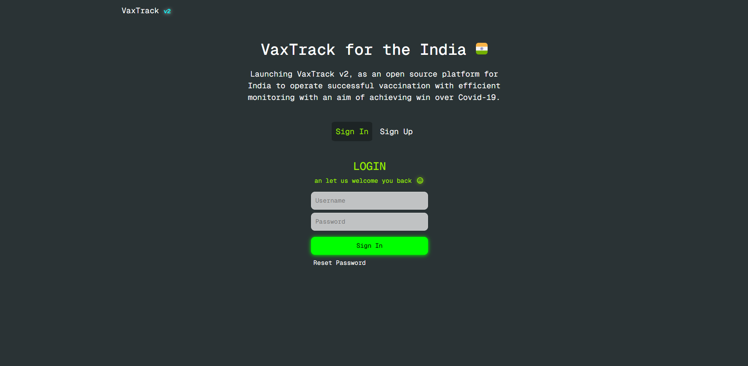
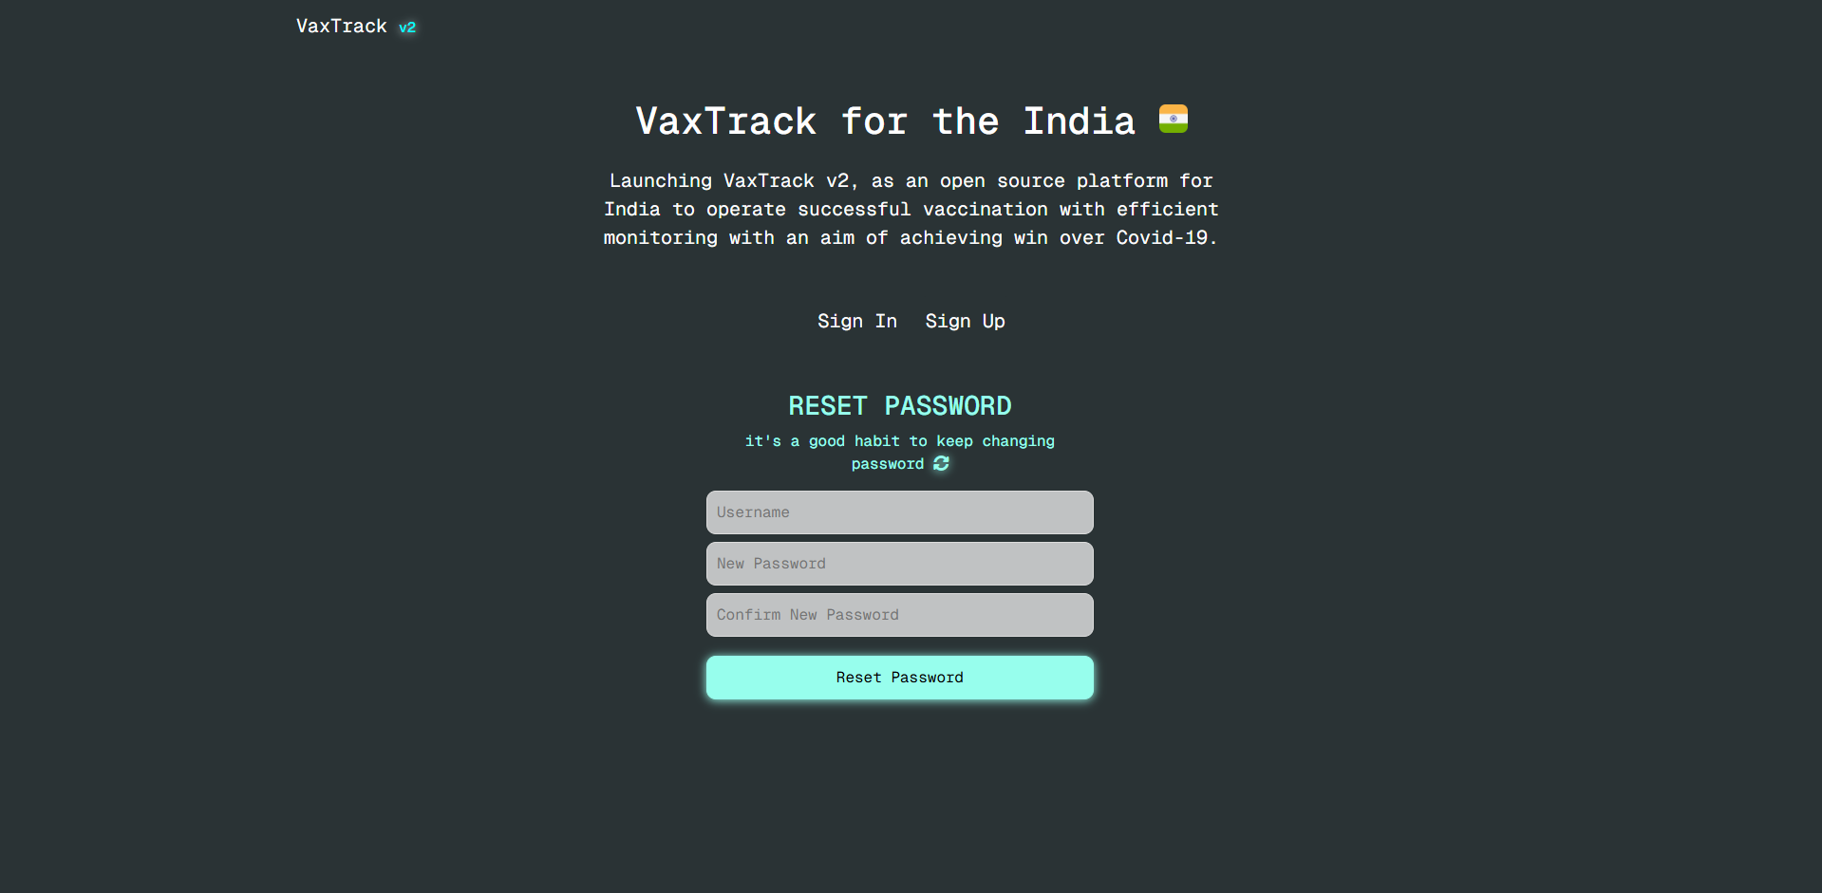
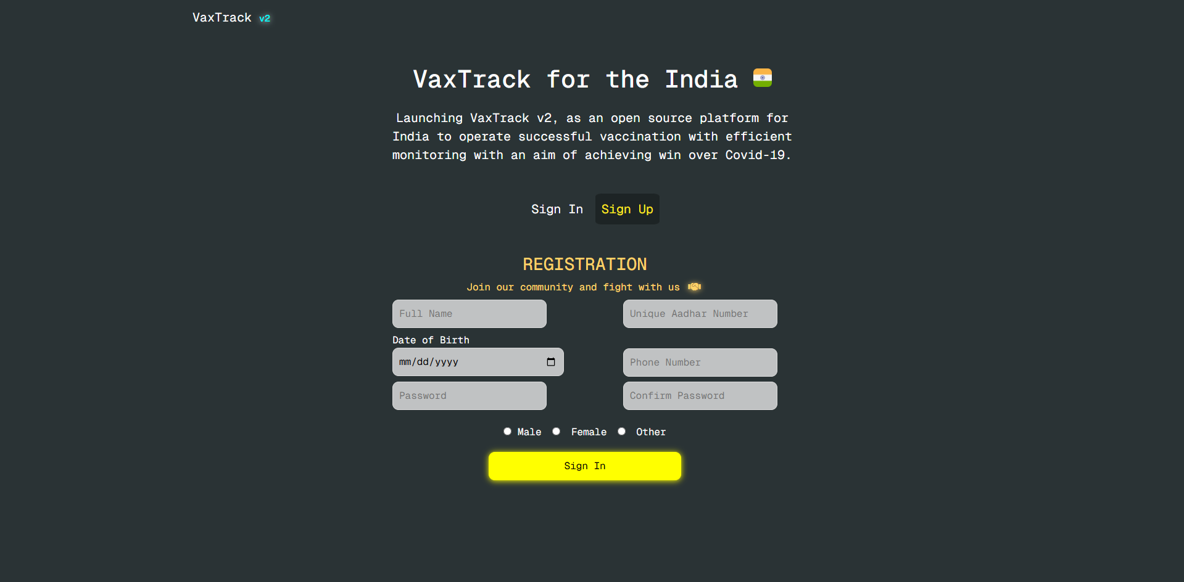
HOME PAGE
On home page itself, two buttons are available to let user do “registration” (in case if user new to platform) and “login” as well as “reset password” in case if you forget or want to update your password.
First pic, allows user to login to app using their username and password, with option to reset password.
Second pic, allows user to reset password for their username.
Third pic, allows user to fill the registration form and on submission user will get logged into their profile automatically.

Slide 12
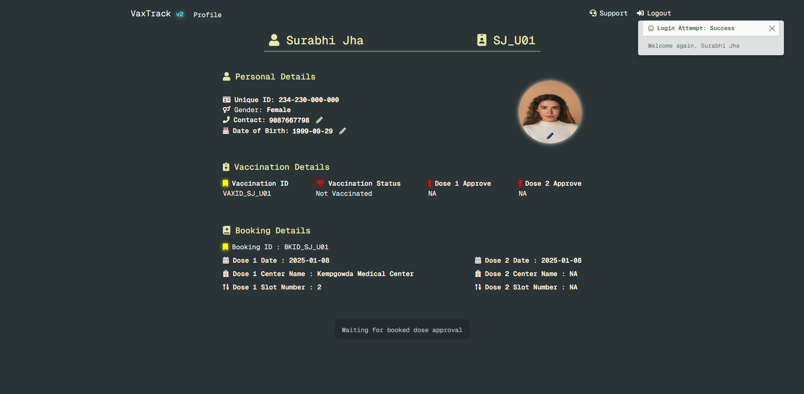
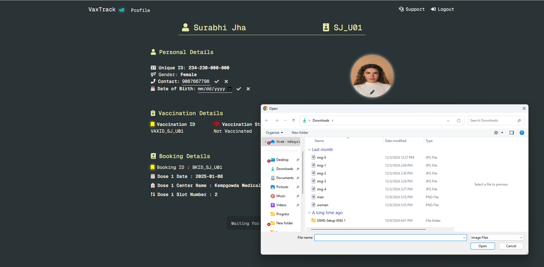
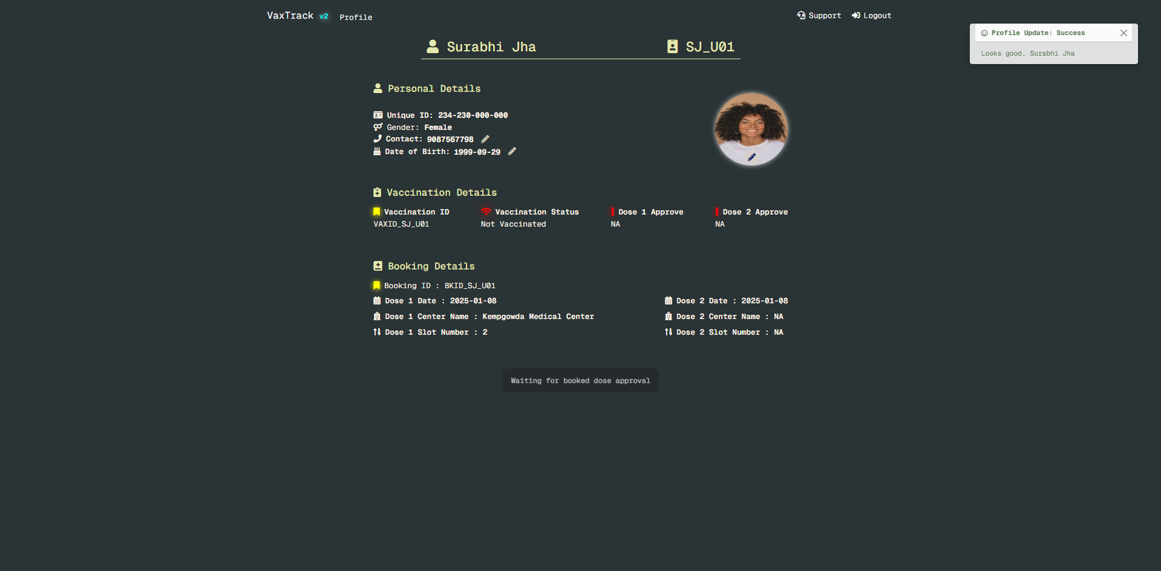
USER PROFILE PAGE
User profile page, as name suggests this page is basically for user information about their personal, vaccination as well as booking details.
User can find details on their vaccination status along with dates and vaccination centers where doses have been taken under booking details.
This page itself provides editing facilities too, to edit personal details only (phone and date of birth), along with profile pic update.
This page is having option to book slots in case if you haven’t done. Or book slot for dose 2 in case dose 1 is approved by admin.

Slide 13
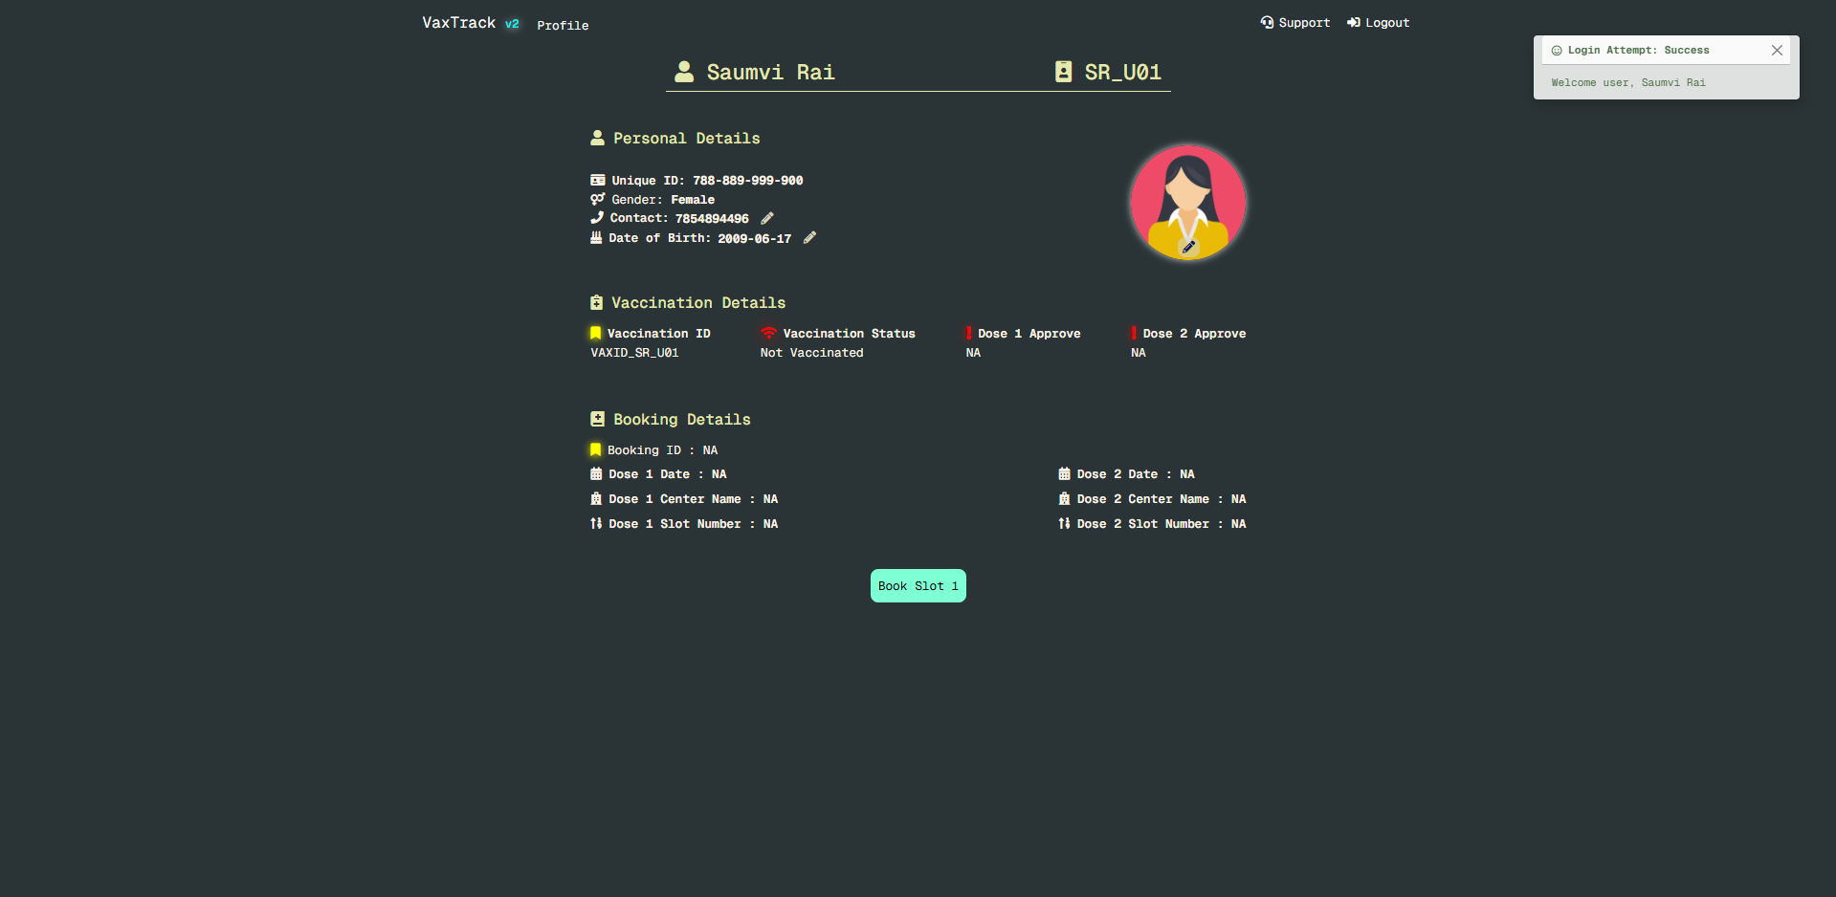
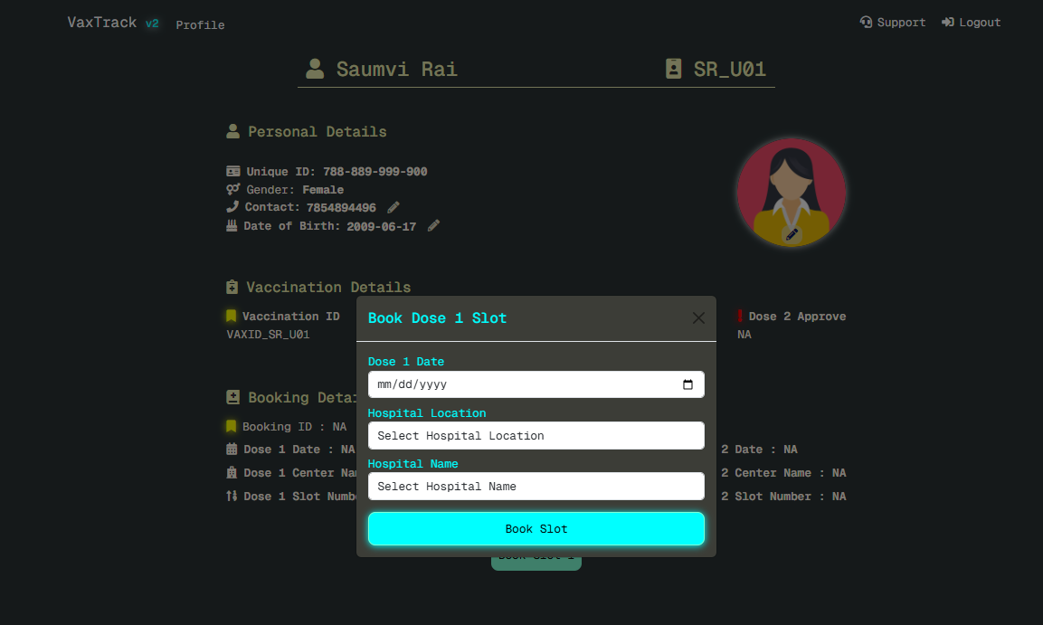
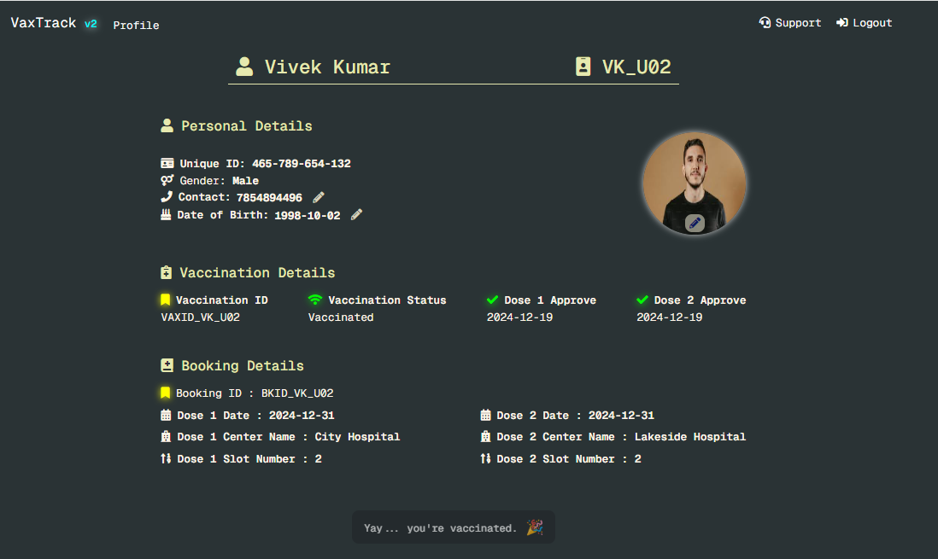
SLOT BOOKING
First snapshot shows that user haven’t booked any slots hence app showing to book for dose 1 as only option.
Second pic shows the dialogue box through which user can select the date, location and vaccination center available in selected location.
Once booked user will see waiting/pending message instead of button. Only admins can approve the booked users requested.
Third pic shows that, user have booked both slots and even got approved by admin and his vaccination details along with booking details are also updated with congratulation message.

Slide 14
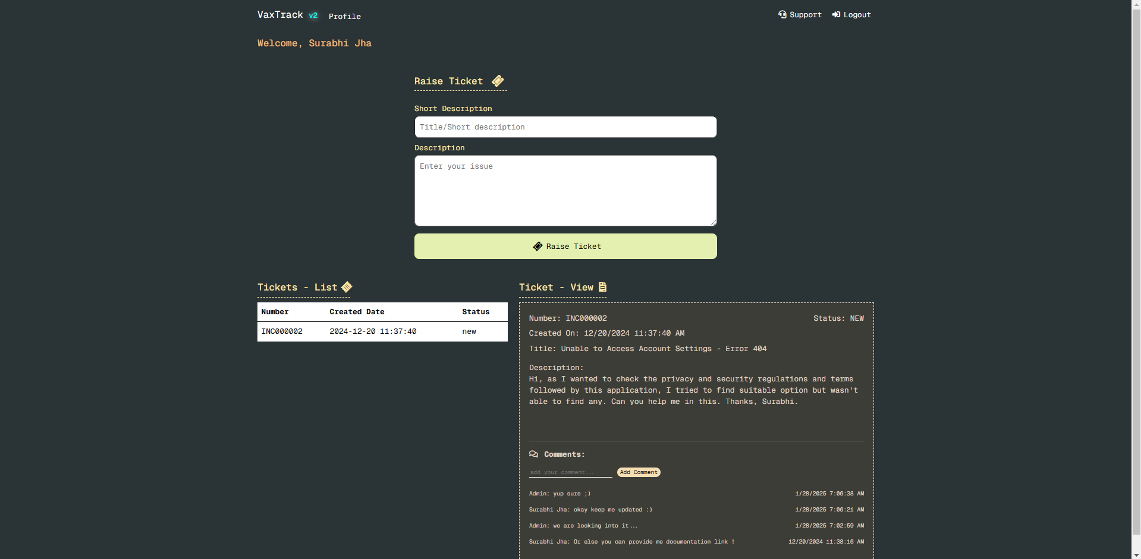
SUPPORT PAGE
Support page allows user to raise new tickets as incidents in case they facing any issues for application’s services.
Raised tickets by user will be listed on the same page so that user can follow up and back track in case of requirement.
User can also access full details on ticket and along with title and description, user can also add comments to ask/converse follow up questions with app admins.

Slide 15
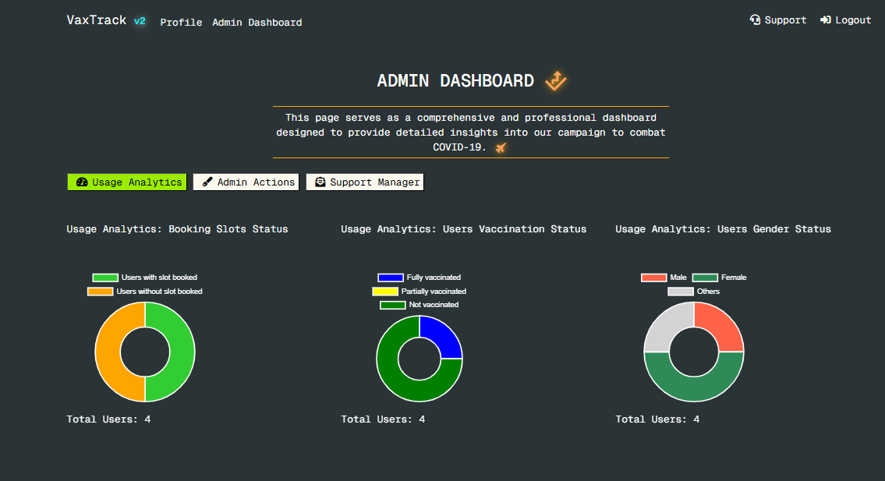
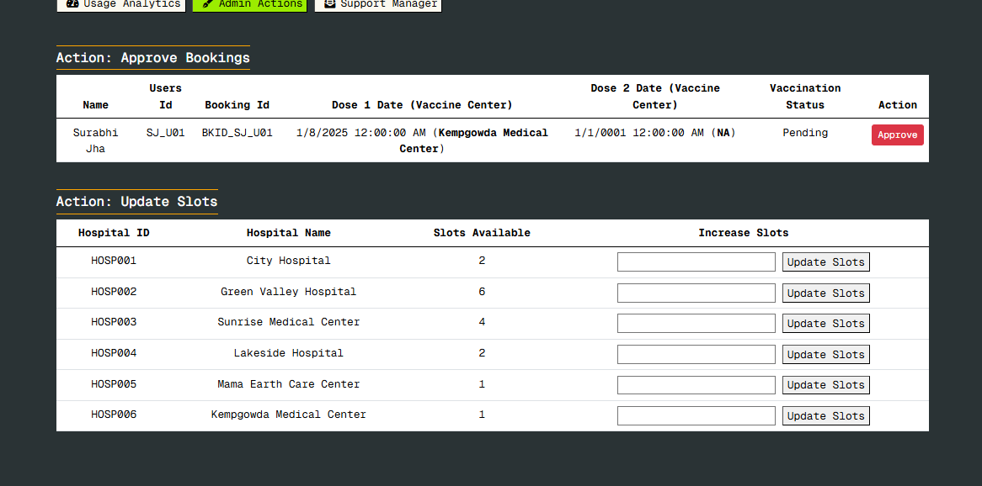
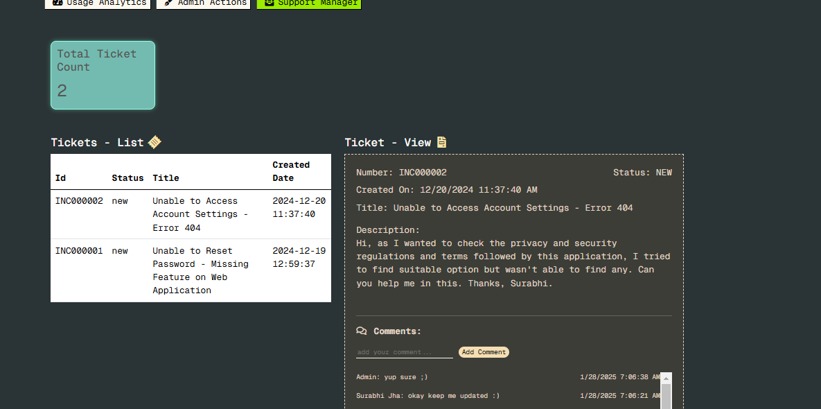
ADMIN DASHBOARD
Admin dashboard provides three tabs – usage analytics, admin actions, support manager.
First pic – Usage Analytics, allows admin to keep track on application stats as shown in pic.
In future, dev can add more graphs, charts, etc. depending on business requirements.
Second pic – Admin Actions, allows admin to approve booked slots, update vaccine center’s slots.
Making slots zero of center, will automatically hide the centers for end users.
Third pic – Support Manager, allows admin to go through tickets raised by end users and add comments on particular ticket as an update for end users.
In future, dev can multiple cards showing ticket stats, SLA and OLA tracker, status update, file upload etc.

Slide 16
LEFTOVERS AND FUTURE ENHANCEMENT SCOPES
Support Module/Support Manager Module - files/media upload feature
Support Manager Module - ticket status update
Support Manager Module - SLA and OLA tracker
Notification Module - for updates on ticket by either side (end users or admins)
Code Cleanup - redundant codes in support and support manager services : typical dev probs, I was too lazy atm ;)
Additional Points:
For me it was for demo purpose but if someone wants to scale up the project, You might need to first refine codes on below points,
Exception Handling - need to handle in all controllers (I have done it but only on selective methods)
Asynchronization - need to check and implement (I have done it but only on selective methods)
Dependency on 3rd Party Libraries - to avoid processing time if requires, also ensure security if library is in-built by MS.
Use Queue with Batch - I haven't used, but in case if requires to interact with Database with API call for bulk data/records (reduce processing time).

Slide 17
CONCLUSION
To wrap up, our Vax Track vaccination portal, built with the ASP.NET MVC framework, simplifies the vaccination process for users and administrators alike. It offers easy registration, slot booking, and robust admin tools for managing approvals and slot availability. This project not only meets current needs but also sets the stage for future improvements in public health management. Thank you for your time.
Thank You
Vivek Kumar
Associate Consultant | Infosys
Developer | British Petroleum

